Slide 1
HTTP/2

Slide 2
Over 20 years ago
HTTP 1.0 – 1996
Single request/response
HTTP 1.1 – 1999
Authentication
Virtual Hosts (Host header)
Caching
Multiple requests
Persistent connections
Response compression

Slide 3
PROTOCOL
HTTP 1.1
telnet adsar.co.uk 80
Trying 138.68.176.140...
Connected to adsar.co.uk.
Escape character is '^]'.
GET / HTTP/1.1
Host: www.adsar.co.uk
HTTP/1.1 200 OK
Date: Thu, 11 Oct 2018 15:47:05 GMT
Server: Apache/2.2.15 (CentOS)
X-Powered-By: PHP/5.6.36
Content-Length: 2466
Connection: close
Content-Type: text/html; charset=UTF-8
<html>
<title>adsar</title>
HTTP 1.0
telnet adsar.co.uk 80
Trying 138.68.176.140...
Connected to adsar.co.uk.
Escape character is '^]'.
GET / HTTP/1.0
<html>
<title>adsar</title>

Slide 4
Coder hacks to > speed
Image sprites
JSS/CSS concatenation
Domain sharding
Inlining

Slide 5
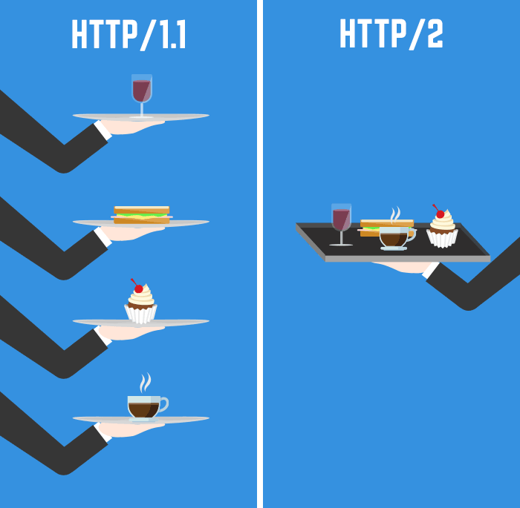
http/2
Header compression
Cypto required
Interleaving requests & responses / multiplex
Server push
Binary instead of text
Remove all the hacks!

Slide 6
Browser support

Slide 7
Getting it into production
Apache 2.4.17 it’s now available in mod_http2
Nginx 1.13.9 supports HTTP2 via ngx_http_v2_module
Either cross fingers your repo has these latest versions, or build from source

Slide 8
Cloudflare
Gives you HTTP/2 out of the box
Communication to your current servers is still HTTP/1.1 – but caching static content gives you HTTP/2 functionality

Slide 9
Server push
Send stuff to the client without them asking for it
Link: </css/styles.css>; rel=preload; as=style
In PHP –
header("Link: </css/styles.css>; rel=preload; as=style, </js/javascript.js>; rel=preload; as=script;", false);

Slide 10
Example
DOM ready in 1300ms

Slide 11
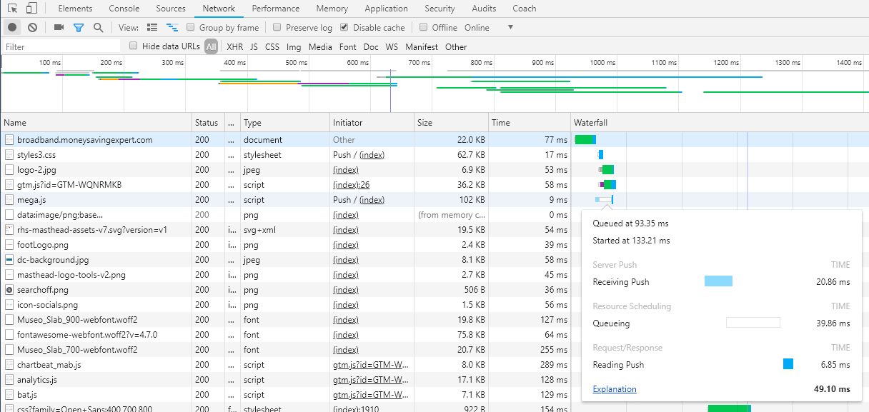
IN ACTION
DOM ready in 650ms

Slide 12
But why?

Slide 13
Demo
https://www.cloudflare.com/http2/

Slide 14
HTTP/2

